Slide 1
Landmark MBC - Stockton

Slide 2
The Bible in 8 Ages

Slide 3
The Bible in 8 Ages

Slide 4
A Study of God’s Dispensations and Covenants

Slide 5
Introduction to Dispensations
And God in eternity past.

Slide 6
In the beginning God…

Slide 7
בְּרֵאשִׁ֖ית בָּרָ֣א אֱלֹהִ֑ים אֵ֥ת הַשָּׁמַ֖יִם וְאֵ֥ת הָאָֽרֶץ
“In the beginning God created the heavens and earth.”
Genesis 1:1

Slide 8
“that in the dispensation of the fullness of the
times He might gather together in one all things in Christ, both which are in heaven and which are on earth—in Him.”
Ephesians 1:10

Slide 9
“indeed you have heard of the dispensation of the grace of God which was given to me for you,”
Ephesians 3:2

Slide 10
This study became popular in our work through the writings of two men…
J.R. Graves – “The Seven Dispensations”
L.D. Foreman – “The Bible in Eight Ages”

Slide 11
In the mid 1800’s John Darby formalized the teaching as we know it.
It grew in popularity with the publication of the Scofield Reference Bible in the early 1900’s.

Slide 12
But this form of systematic Bible study had much earlier foundations.
The original teaching and concept is found in the “Shepherd of Hermas,” Circa 2nd Century.

Slide 13
What is ‘Dispensationalism?’
It is simply a way of ordering things – also translated – an ‘administration’.
It is a system, in theology, of viewing the Divine administration of God’s periods of time.

Slide 14
What is ‘Dispensationalism?’
Dispensationalism is a theological system that recognizes different ages ordained by God to order the affairs of the world.
Dispensationalism has 2 primary distinctives:

Slide 15
What is ‘Dispensationalism?’
1). A consistent literal interpretation of Scripture –
Especially Bible prophecy.

Slide 16
What is ‘Dispensationalism?’
A view of the uniqueness of Israel as being separate from the Church in God’s program.
We reject “replacement theology” – that the Church has replaced Israel – for reasons we shall see.

Slide 17
What is ‘Dispensationalism?’
Dispensationalists believe in salvation by grace through faith in every age.
God did not have different way or means of salvation for the various ages
(as some opponents accuse).

Slide 18
What is ‘Dispensationalism?’
Dispensationalists hold to a literal interpretation of the Bible as the best hermeneutic.
The literal interpretation give each word the meaning it would commonly have in everyday usage.

Slide 19
What is ‘Dispensationalism?’
Allowances are made for symbols, figures of speech, and types (of course).
It is understood that even symbols and figurative sayings have literal meanings behind them.

Slide 20
What is ‘Dispensationalism?’
EXAMPLE: Revelation 20 speaks of a “thousand years” – we interpret it as a literal period of 1,000 years.
There is no reason to interpret it otherwise.

Slide 21
What is ‘Dispensationalism?’
Literalism is the best way to view Scripture.
1). Philosophically – the purpose of language itself requires we interpret words literally.
Language was given by God to be able to communicate.

Slide 22
Literalism is the best way to view Scripture.
2). Biblically – every prophecy about Jesus in the O.T. was fulfilled literally.
Jesus’ birth, ministry, death and resurrection all occurred exactly as the O.T. predicted.

Slide 23
What is ‘Dispensationalism?’
Literalism is the best way to view Scripture.
The prophecies were literal.
There is no ‘non-literal’ fulfillment of messianic prophecies in the N.T.

Slide 24
What is ‘Dispensationalism?’
Literalism is the best way to view Scripture.
Without a literal interpretation in studying Scripture,
…there is no objective standard by which we understand the Bible.

Slide 25
What is ‘Dispensationalism?’
There are two distinct ‘Covenant’ peoples of God:
Israel and the Church.
Salvation is now and has always been by grace through faith alone.

Slide 26
What is ‘Dispensationalism?’
There are two distinct ‘Covenant’ peoples of God:
In the O.T. = faith in God.
In the N.T. = Specifically in God the Son.
The Church has not ‘replaced’ Israel in God’s program…

Slide 27
There are two distinct ‘Covenant’ peoples of God:
...The O.T. promises to Israel have not been transferred to the Church.
The promises God made to Israel in the O.T. (for land, many descendants & blessings), will be fulfilled…

Slide 28
There are two distinct ‘Covenant’ peoples of God:
...in the 1,000 year/Millennial reign - Revelation 20
God is, in this current age, focusing His attention on the Church.
He will soon focus His attention on Israel.

Slide 29
These ages or dispensations are not paths to salvation…
...but manners in which God relates to mankind.
Each dispensation includes a recognizable pattern of how God worked with people living in the age/dispensation.

Slide 30
Dispensationalism as a system…
…keeps us from falling into faulty Bible interpretation – “what this passage says to me”
...instead of “the Bible says.”
Another result – a future view of prophecy and a premillennial interpretation of Christ’s second coming.

Slide 31
What are the 8 Ages?
1 – God in eternity past
2 – Adamic Age – innocence
3 – Flood Age – Human Gov.
4 - Abrahamic Age - Promise

Slide 32
What are the 8 Ages?
5 – Law Age – Mosiac Covenant
6 – Church Age – Grace to all
7 – Millennial Reign – Kingdom
8 – Heaven Age – Eternity future

Slide 33
God in Eternity Past
Adamic Age
Flood Age
Patriarch Age
Law Age
Church Age
Millennium Kingdom Age
Heaven Age – Eternity Future
Overview of 8 Ages

Slide 34
God in Eternity
Adam Creation
Noah Flood
Abraham Promise
Moses
Law
Church Grace
1,000 yr
Kingdom
Heaven - Eternity
Eternal God

Slide 35
God’s Command
Man’s Responsibility
Man’s Failure
Judgment
God's Grace

Slide 36
Opening Event
Man’s Responsibility
Man’s Failure
Man’s Tendency
God's Grace - Personal Salvation
Closing Event

Slide 37
God in eternity past

Slide 38
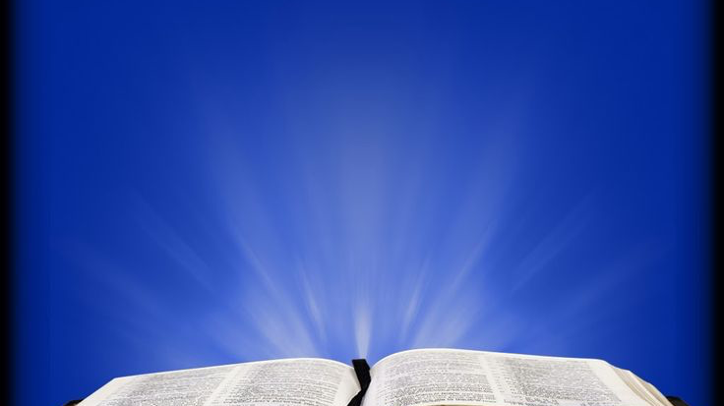
“In the beginning GOD…”
God existed - eternally.
A proper view of God will enhance your Christian life.

Slide 39
WHO IS GOD?
GOD is -
Spirit
Person
Life

Slide 40
WHO IS GOD?
GOD is - The self-existent Being
Unity (one God)
Unchangeable
Eternal & Immense

Slide 41
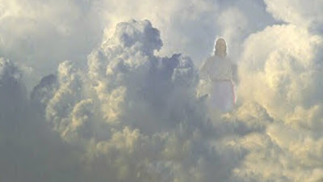
Job 38:1-7
Then the Lord answered Job out of the whirlwind, and said:
“Who is this who darkens counsel
By words without knowledge?

Slide 42
Now prepare yourself like a man;
I will question you, and you shall answer Me.
“Where were you when I laid the foundations of the earth?
Tell Me, if you have understanding.

Slide 43
Who determined its measurements?
Surely you know!
Or who stretched the line upon it?
To what were its foundations fastened?
Or who laid its cornerstone,

Slide 44
When the morning stars sang together,
And all the sons of God shouted for joy?

Slide 45
God is spirit=
Immaterial,
Incorporeal,
Invisible

Slide 46
God is person=
Self-awareness & self-determination –Exo.3:13-14,
Intellect –Gen. 18:19,
Emotions – Gen. 6:6,
Will – Gen. 3:15

Slide 47
God is life=
‘Living God’ –having in His own being a source of being and activity- both for Himself & others.

Slide 48
God is Self-existent=
Unlimited,
Has always existed,
Eternal.

Slide 49
God is Immutable =
Unchanging nature (cannot become better),
Declared unchangeable in duration & life…

Slide 50
God is Immutable =
Unchangeable in nature, Unchangeable will,
Unchangeable character – justice, mercy, truth…

Slide 51
God is Eternal & Immense
Unlimited - time & space, One – Unity in trinity,
He is before all things, sustains & intel. cause

Slide 54
